Slide 1
Project 3
Operation Analytics and Investigating Metric Spike
From: Avinash Nayak

Slide 2
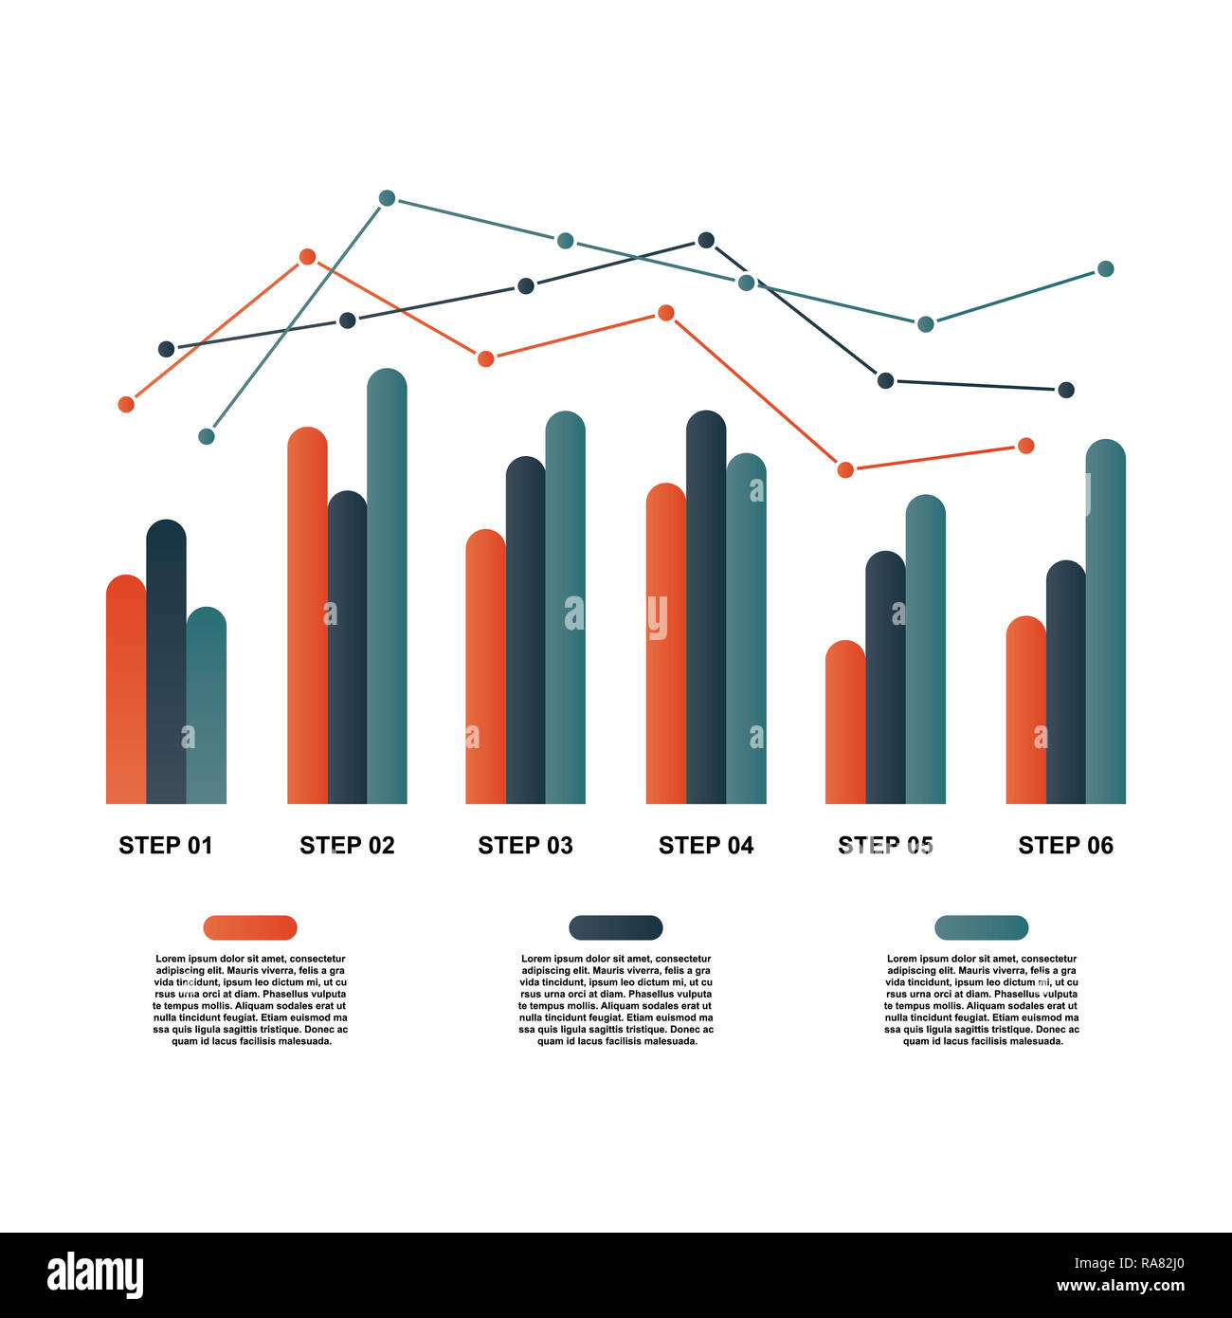
Project Description
This Project is about understanding the working of Operational Analytics of an organization that helps them identify areas which need improvements.
It also involves investigating Metric Spikes which can explain sudden rise or drop in key metrics.
These analysis are to be done using Data Analytics tools and processes.
As a Lead Data Analyst in Microsoft, we received datasets and queries from various departments and we are required to provide insights to those queries.
To do this, we will use SQL to extract and filter data from the datasets provided and analyse them to get the required insights.
Image Source: Google Images

Slide 3

Approach
This project has two Case Studies. Case Study 1 is related to job reviews of candidates and Case Study 2 is related to events that users have performed in online space.
For Case Study 1, we had one table named job_data which has information about job id, actor id, time to review, date of review, language and outcome of review.
For Case Study 2, we had three tables, users with information in each row, about a user’s account, events with information in each row, about any event in online space a user has performed and email_events with information in each row, about any event related to emails the user has performed.
Image Source: Google Images

Slide 4



Approach
We first studied and tried to understand the data for each case study. Then we started extracting information from the data as per the questions we had (we would have processed the data like cleaning, transforming etc. if required).
Extraction of data was done using pandas and pymysql libraries in python. We also plotted different types of graphs for better understanding of the data. Then from extracted data and graphs, we were able to drew conclusions and insights. Now, since we got all the insights required, we will be able to make a detailed report about it.
Image Source: Google Images

Slide 5



Tech-Stack Used
MySQL Workbench 8.0.33 Community Version – A relational database management system used to create the database. It’s connections are used to connect the database with Python.
Python 3.10.9 – Programming language used to extract and filter data as per requirements using SQL Queries.
Jupyter Notebook 6.5.2 – Interactive platform to write and execute codes in various programming languages (in this case Python).
Image Source: Google Images

Slide 6
Insights
Case Study 1: Job Data Analysis
Table: job_data
Table name used in project: cs_1
Description: Contains details about job reviews
P.S.: The original table had only 8 rows. Analyzing this small table wouldn’t had provided much accurate insights to us. So I had added extra rows in the table. The modified table can be found in the given link. (https://drive.google.com/file/d/1-F_bwHDe5GDzNiGBgFMg9iJlGtA0rPG_/view?usp=sharing)

Slide 7
Insights
Case Study 1: Job Data Analysis
A. Jobs Reviewed Over Time:
Objective: Calculate the number of jobs reviewed per hour for each day in November 2020.
Task: Write an SQL query to calculate the number of jobs reviewed per hour for each day in November 2020.
Query:-
query='''SELECT ds AS Date, COUNT(job_id) AS Cnt_JID, ROUND((SUM(time_spent)/3600),2) AS Tot_Time_Sp_Hr, ROUND((COUNT(job_id)/(SUM(time_spent)/3600)),2) AS Job_Rev_PHr_PDy
FROM cs_1
WHERE ds BETWEEN \'01-11-2020\' AND \'30-11-2020\'
GROUP BY ds
ORDER BY ds'''
df1=pd.read_sql_query(query, conn)

Slide 8
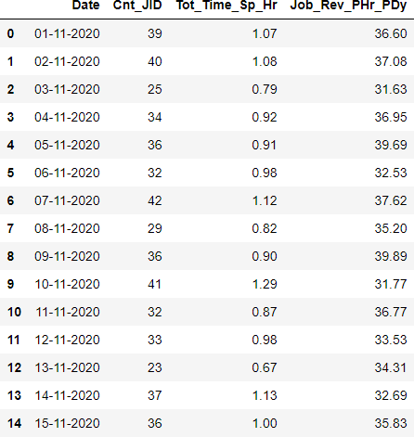
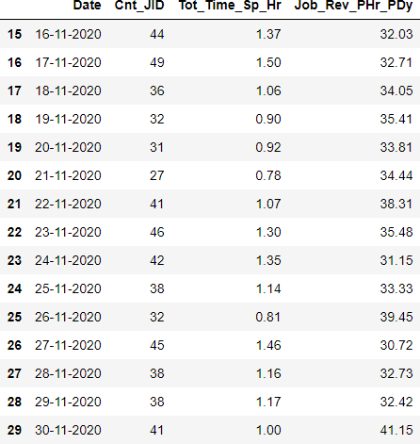
Insights
Case Study 1: Job Data Analysis
Result:-

Slide 9
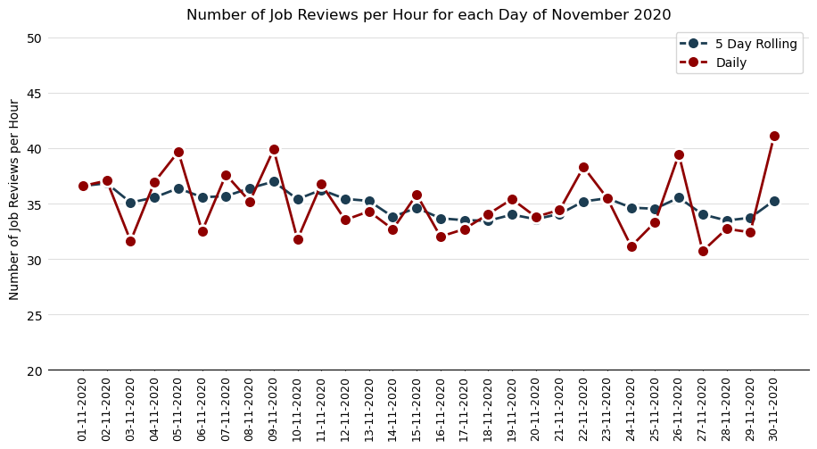
Insights
Case Study 1: Job Data Analysis
Result:-

Slide 10
Insights
Case Study 1: Job Data Analysis
Insights:-
From the table, we can see that the number of job reviews done for most days of November 2020 was between 30 and 45.
From the table, we can observe that the total time spent for job reviews on most days of November 2020 was between 0.9 and 1.4 hours.
From the plot, we cannot observe any particular trend, but hourly rate of job reviews for each day is between 30 and 42.
From the plot, if we observe the last four days, which were Friday, Saturday, Sunday and Monday, the low hourly review rate of Friday, Saturday and Sunday can be contributed to high lethargy of employees due to weekend time. The high hourly review rate on Monday can be contributed to the last working day of the month and also to the pile up of job reviews of Friday, Saturday and Sunday.
From the plot, we can observe that the 5 day rolling average (we calculated this metric using pandas library of python programming language) has an overall slight downward trend. This signifies that the hourly rate of job reviews is slowly decreasing.

Slide 11
Insights
Case Study 1: Job Data Analysis
B. Throughput Analysis:
Objective: Calculate the 7-day rolling average of throughput (number of events per second).
Task: Write an SQL query to calculate the 7-day rolling average of throughput. Additionally, explain whether you prefer using the daily metric or the 7-day rolling average for throughput, and why.
Query:-
query="""WITH d AS (
SELECT ds, CAST(COUNT(job_id) AS FLOAT)/CAST(SUM(time_spent) AS FLOAT) AS c_by_s
FROM cs_1
WHERE ds BETWEEN \'01-11-2020\' AND \'30-11-2020\'
GROUP BY 1 )
SELECT ds AS Date, c_by_s AS Job_Rev_PSec_PDy, AVG(c_by_s) OVER(ORDER BY ds ROWS BETWEEN 6 PRECEDING AND CURRENT ROW) AS 7_Dy_Roll_Avg
FROM d"""
df2=pd.read_sql_query(query, conn)

Slide 12
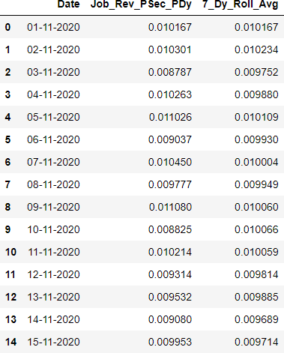
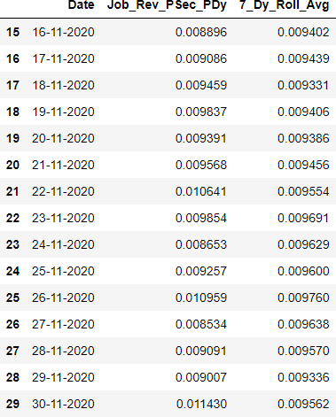
Insights
Case Study 1: Job Data Analysis
Result:-

Slide 13
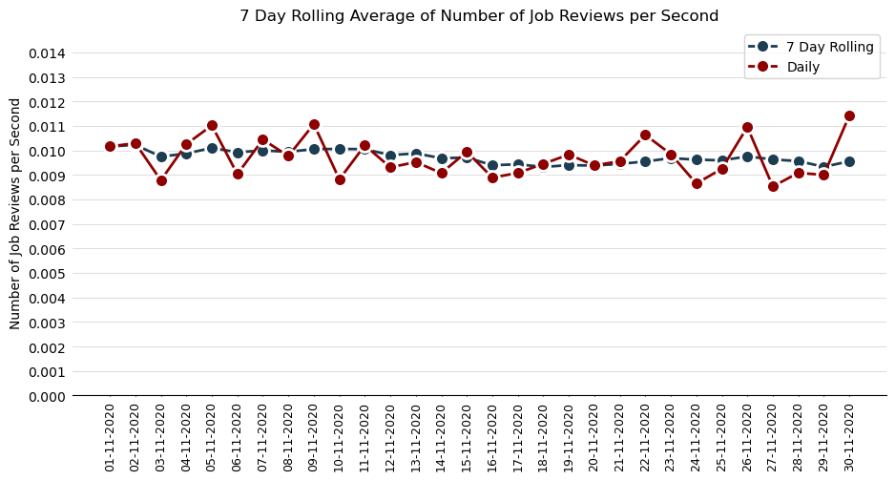
Insights
Case Study 1: Job Data Analysis
Result:-

Slide 14
Insights
Case Study 1: Job Data Analysis
Insights:-
From the daily line plot, we cannot observe any particular trend, but job reviews per second for each day is between 0.008 and 0.012.
From the 7-day rolling average plot, we can observe that the 7 day rolling average has an overall slight downward trend. This signifies that the rate of job reviews is slowly decreasing.
We should prefer the 7-Day Rolling Average over daily metric for thoroughput. The reason being daily metrics can go up or down on a daily basis for factors that cannot be controlled by the organizations like seasonality, major events etc. Sudden spikes caused by these factors can give a false signal which can prompt the organization to take steps which may prove to be harmful. So to get a real sense of the thoroughput data, we should use the 7-day rolling average as they are very less impacted by above mentioned factors and can give a realistic sense of the data.

Slide 15
Insights
Case Study 1: Job Data Analysis
C. Language Share Analysis:
Objective: Calculate the percentage share of each language in the last 30 days.
Task: Write an SQL query to calculate the percentage share of each language over the last 30 days.
Query:-
query="""WITH d AS (
SELECT language, COUNT(language) AS cnt
FROM cs_1
WHERE ds BETWEEN \'01-11-2020\' AND \'30-11-2020\'
GROUP BY language )
SELECT language AS Language, cnt AS Tot_Cnt_Lang, ROUND((100*cnt/SUM(cnt) OVER()), 2) AS Perc_Share_Lang
FROM d
ORDER BY Perc_Share_Lang DESC"""
df3=pd.read_sql_query(query, conn)

Slide 16
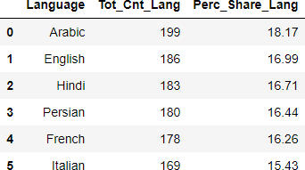
Insights
Case Study 1: Job Data Analysis
Result:-

Slide 17
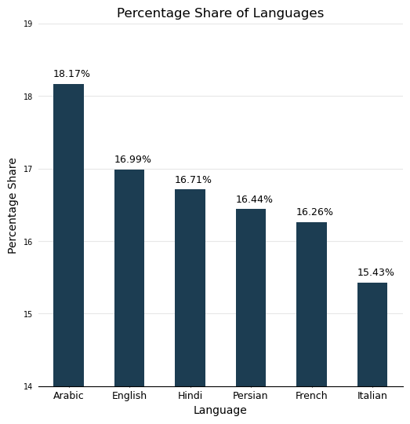
Insights
Case Study 1: Job Data Analysis
Result:-

Slide 18
Insights
Case Study 1: Job Data Analysis
Insights:-
From the table and the plot, we can observe that Arabic language is the most used language with percentage share of 18.17% followed by English with 16.99% and Hindi with 16.71%.
Although Arabic is the most used language, the percentage share of languages is not skewed in any one language’s favour.

Slide 19

Insights
Case Study 1: Job Data Analysis
D. Duplicate Rows Detection:
Objective: Identify duplicate rows in the data.
Task: Write an SQL query to display duplicate rows from the job_data table.
Query:-
>> First we will check whether there are rows which are entirely duplicate.
query="""SELECT *
FROM cs_1
GROUP BY ds, job_id, actor_id, event, language, time_spent, org
HAVING COUNT(*)>1"""
df4a=pd.read_sql_query(query, conn)
Result:-
Insights:-
All the rows are unique when considered in its entirety

Slide 20
Insights
Case Study 1: Job Data Analysis
D. Duplicate Rows Detection:
Objective: Identify duplicate rows in the data.
Task: Write an SQL query to display duplicate rows from the job_data table.
Query:-
>> Second we will check whether there are rows which have duplicate job_id values. The below query gives all the job_ids with duplicate entries along with their counts.
query1a="""SELECT job_id, COUNT(job_id) AS Cnt_JID FROM cs_1
GROUP BY job_id
HAVING Cnt_JID>1
ORDER BY job_id"""
df4b=pd.read_sql_query(query1a, conn)

Slide 21
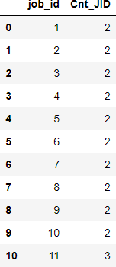
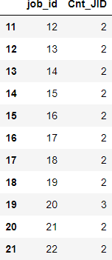
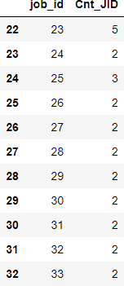
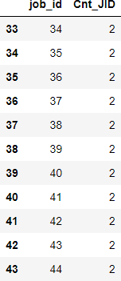
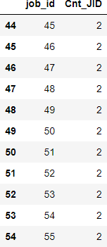
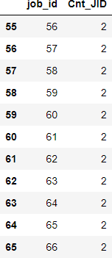
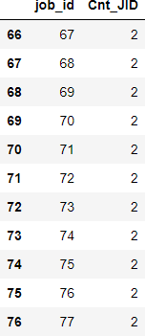
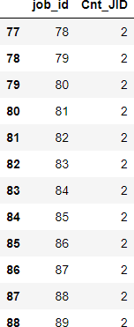
Insights
Case Study 1: Job Data Analysis
Result:-
Result:-

Slide 22
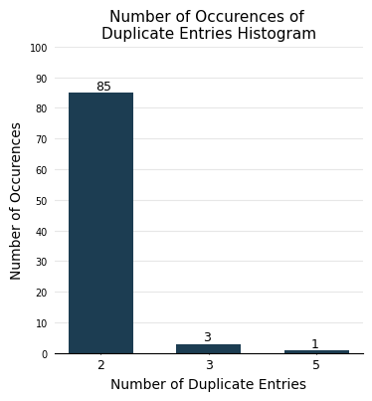
Insights
Case Study 1: Job Data Analysis
Result:-

Slide 23
Insights
Case Study 1: Job Data Analysis
D. Duplicate Rows Detection:
Objective: Identify duplicate rows in the data.
Task: Write an SQL query to display duplicate rows from the job_data table.
Query:-
>> The below query gives all the row entries whose job_ids are given above.
query1b="""SELECT cs_1.*
FROM cs_1
JOIN ({}) AS q1
ON cs_1.job_id=q1.job_id
ORDER BY cs_1.job_id""".format(query1a)
df4c=pd.read_sql_query(query1b, conn)

Slide 24
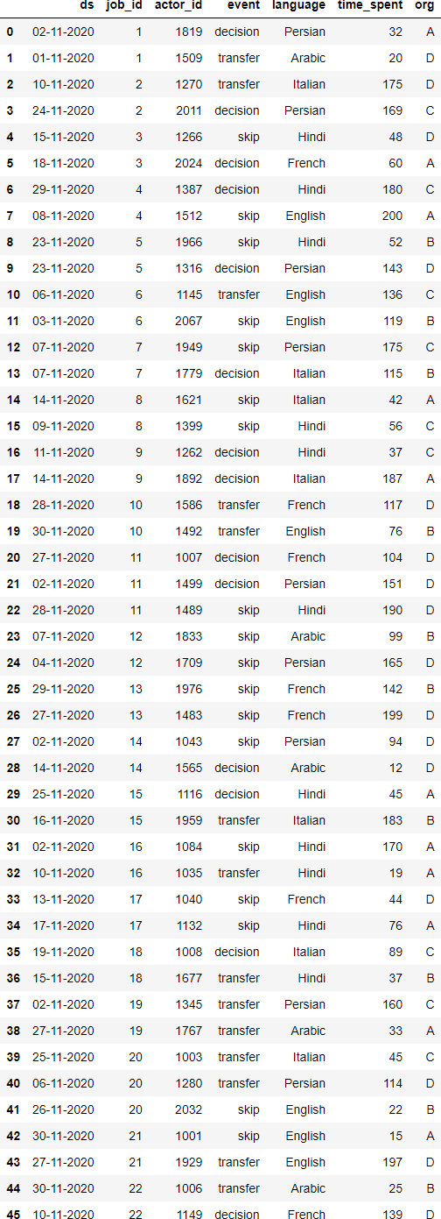
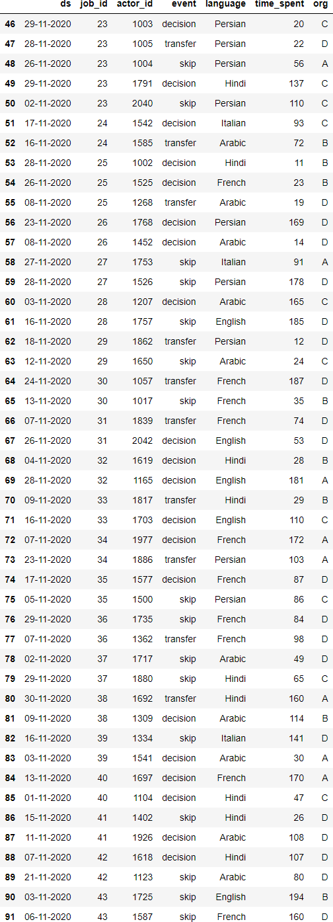
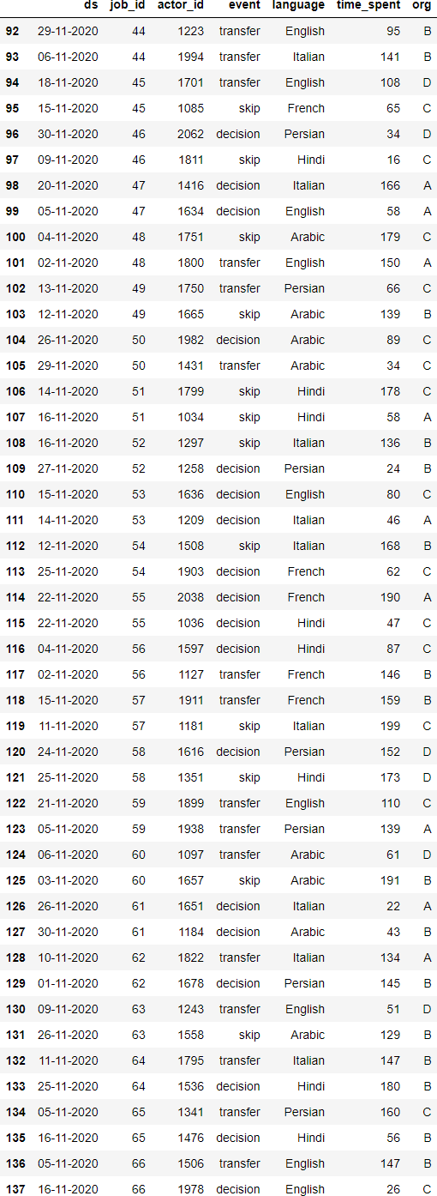
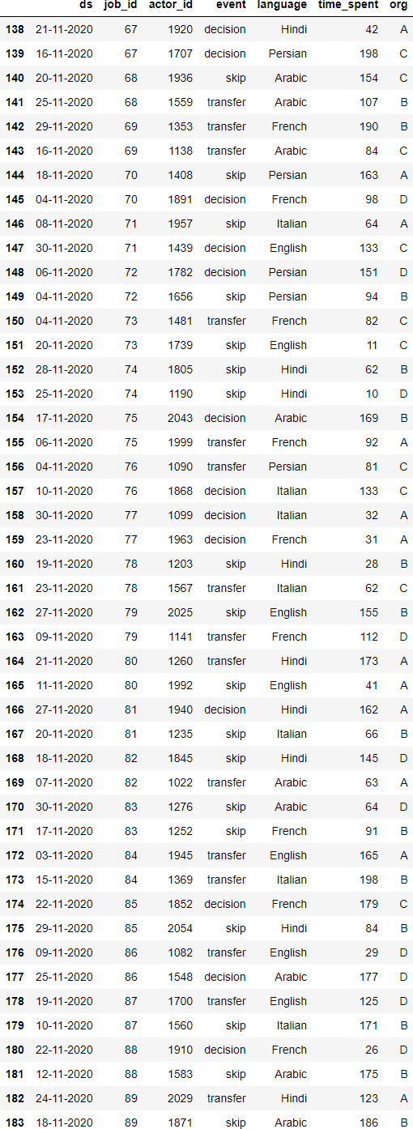
Insights
Case Study 1: Job Data Analysis
Result:-
Insights:-
There are 89 number of rows with duplicate values of job_id.
Out of those 89 number of job_ids, 85 have 2 number of duplicate rows, 3 have 3 number of duplicate rows and 1 have 5 number of duplicate rows.
These rows needs to be either removed or find the correct job_id and replace them here.

Slide 25
Insights
Case Study 1: Job Data Analysis
D. Duplicate Rows Detection:
Objective: Identify duplicate rows in the data.
Task: Write an SQL query to display duplicate rows from the job_data table.
Query:-
>> Third we will check whether there are rows which have duplicate actor_id values. The below left query gives all the actor_ids with duplicate entries along with their counts and the below right query gives all the row entries whose actor_ids are given above.
query2a="""SELECT actor_id, COUNT(actor_id) AS Cnt_AID
FROM cs_1
GROUP BY actor_id
HAVING Cnt_AID>1
ORDER BY actor_id"""
df4d=pd.read_sql_query(query2a, conn)
query2b="""SELECT cs_1.*
FROM cs_1
JOIN ({}) AS q1
ON cs_1.actor_id=q1.actor_id
ORDER BY cs_1.actor_id""".format(query2a)
df4e=pd.read_sql_query(query2b, conn)

Slide 26
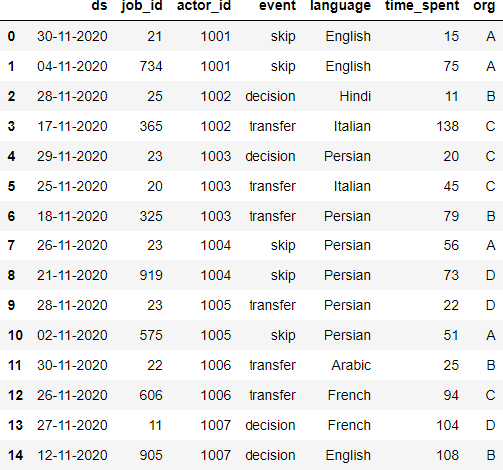
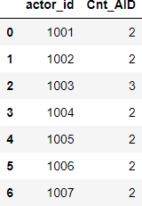
Insights
Case Study 1: Job Data Analysis
Result:-
Query2b:-
Query2a:-

Slide 27
Insights
Case Study 1: Job Data Analysis
Insights:-
There are 7 number of rows with duplicate values of actor_id.
Out of those 89 number of actor_ids, 6 have 2 number of duplicate rows and 1 have 3 number of duplicate rows.
These rows needs to be either removed or find the correct actor_id and replace them here.

Slide 28
Insights
Case Study 2: Investigating Metric Spike
Table: users
Table name used in project: cs_2_t_1
Description: Contains descriptive information about a user’s account
Table: events
Table name used in project: cs_2_t_2
Description: Contains information about an event that a user has taken
Table: email_events
Table name used in project: cs_2_t_3
Description: Contains information about events specific to sending of emails

Slide 29
Insights
Case Study 2: Investigating Metric Spike
A. Weekly User Engagement:
Objective: Measure the activeness of users on a weekly basis.
Task: Write an SQL query to calculate the weekly user engagement.

Slide 30
Query:-
query1='''SELECT user_id, TIMESTAMPDIFF(WEEK, \'2013-01-01 04:40:10\', DATE_FORMAT(STR_TO_DATE(occurred_at, \'%d-%m-%Y %H:%i\'), \'%Y-%m-%d %H:%i:%S\')) AS wk
FROM cs_2_t_2
WHERE event_type = \'engagement\''''
query2='''SELECT user_id, TIMESTAMPDIFF(WEEK, \'2013-01-01 04:40:10\', occurred_at) AS wk
FROM cs_2_t_3'''
query3='''SELECT *
FROM ({}) AS q1
UNION ALL
SELECT * FROM ({}) AS q2
ORDER BY user_id'''.format(query1, query2)
query4='''SELECT user_id, wk, COUNT(user_id) AS Count
FROM ({}) AS q3
GROUP BY user_id, wk
ORDER BY user_id'''.format(query3)
query5='''SELECT ROUND(AVG(Count),2) AS Avg_Weekly_User_Eng
FROM ({}) AS q4 '''.format(query4)
df1=pd.read_sql_query(query5, conn)

Slide 31

Insights
Case Study 2: Investigating Metric Spike
Result:-
Insights:-
From our calculations above, the Average Weekly User Engagement is 6.43. That is, on an average, users engage in 6.43 events on weekly basis.

Slide 32
Insights
Case Study 2: Investigating Metric Spike
B. User Growth Analysis:
Objective: Analyze the growth of users over time for a product.
Task: Write an SQL query to calculate the user growth for the product.
Query:-
query1='''SELECT DATE(STR_TO_DATE(created_at, \'%Y-%m-%d %H:%i:%s\')) AS dt, COUNT(user_id) AS cnt
FROM cs_2_t_1
GROUP BY dt''‘
query2='''SELECT dt, cnt, SUM(cnt) OVER (ORDER BY dt) DIV 1 AS cml_cnt
FROM ({}) AS q1'''.format(query1)
df2=pd.read_sql_query(query2, conn)

Slide 33
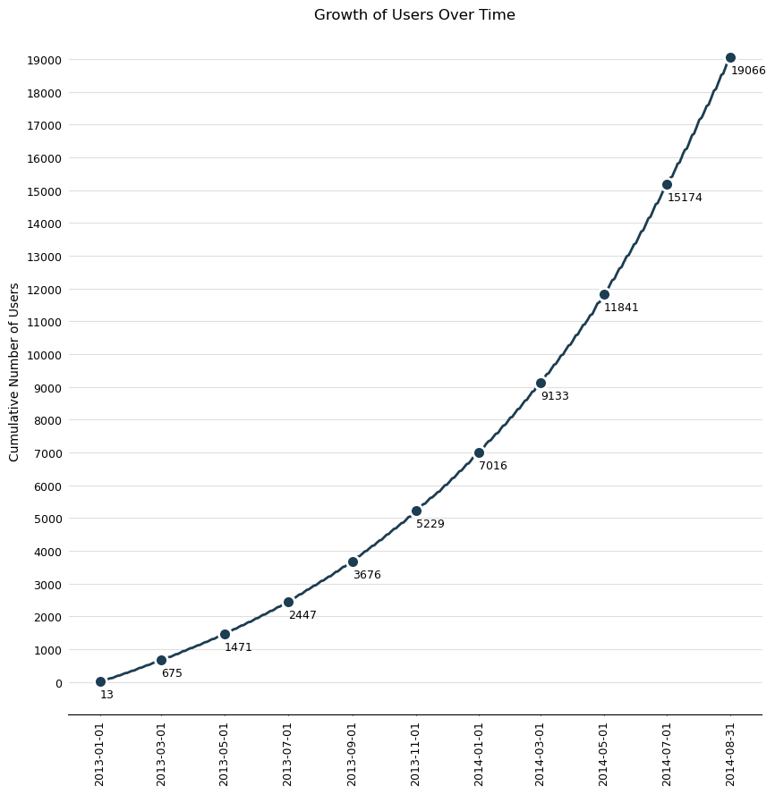
Insights
Case Study 2: Investigating Metric Spike
Result:
Insights:-
From the plot, we can observe that user growth is experiencing almost exponential growth. Here the number of users increased from 13 on 1st January 2013 to 19066 on 31st August 2014.
Exponential growth indicates a positive sign for the organization.

Slide 34
Insights
Case Study 2: Investigating Metric Spike
C. Weekly Retention Analysis:
Objective: Analyze the retention of users on a weekly basis after signing up for a product.
Task: Write an SQL query to calculate the weekly retention of users based on their sign-up cohort.

Slide 35
Query:-
query1='''SELECT user_id, TIMESTAMPDIFF(WEEK, \'2013-01-01 04:40:10\', activated_at) as week_no
FROM cs_2_t_1
WHERE state = \'active\'''‘
query2='''SELECT user_id, DATE_FORMAT(STR_TO_DATE(occurred_at, \'%d-%m-%Y %H:%i\'), \'%Y-%m-%d %H:%i:%S\') AS date_time, TIMESTAMPDIFF(WEEK, \'2013-01-01 04:40:10\', DATE_FORMAT(STR_TO_DATE(occurred_at, \'%d-%m-%Y %H:%i\'), \'%Y-%m- %d %H:%i:%S\')) as week_no
FROM cs_2_t_2 WHERE event_type = \'engagement\‘
UNION ALL
SELECT user_id, occurred_at AS date_time, TIMESTAMPDIFF(WEEK, \'2013-01-01 04:40:10\', occurred_at) as week_no
FROM cs_2_t_3 ORDER BY user_id, week_no'''
query3='''SELECT q1.user_id AS q1id, q1.week_no AS q1wn, q2.user_id AS q2id, q2.week_no AS q2wn
FROM ({0}) AS q1
LEFT OUTER JOIN ({1}) AS q2 ON q1.user_id=q2.user_id
UNION
SELECT q1.user_id AS q1id, q1.week_no AS q1wn, q2.user_id AS q2id, q2.week_no AS q2wn
FROM ({0}) AS q1
RIGHT OUTER JOIN ({1}) AS q2 ON q1.user_id=q2.user_id'''.format(query1, query2)

Slide 36
Query:-
query4='''SELECT q3.q1id AS q3id, q3.q1wn AS q3wn1, q3.q2wn AS q3wn2
FROM ({0}) AS q3
ORDER BY q3wn1, q3wn2'''.format(query3)
query5='''SELECT q1_.week_no AS q5wn, COUNT(q1_.user_id) AS ttl_ui_cnt
FROM ({0}) AS q1_
GROUP BY q5wn'''.format(query1)
query6='''SELECT q4.q3wn1 AS q4wn1, q4.q3wn2 AS q4wn2, COUNT(q4.q3id) AS cnt_q4id
FROM ({0}) AS q4
GROUP BY q3wn1, q3wn2'''.format(query4)
query7='''SELECT q6.q5wn AS q6wn, q7.q4wn2 AS q7wn2, ROUND((100*q7.cnt_q4id/q6.ttl_ui_cnt),2) AS perc_ret
FROM ({0}) AS q6
JOIN ({1}) AS q7
ON (q6.q5wn=q7.q4wn1 AND q6.q5wn<q7.q4wn2)
ORDER BY q6wn, q7wn2'''.format(query5, query6)
df3=pd.read_sql_query(query7, conn)

Slide 37
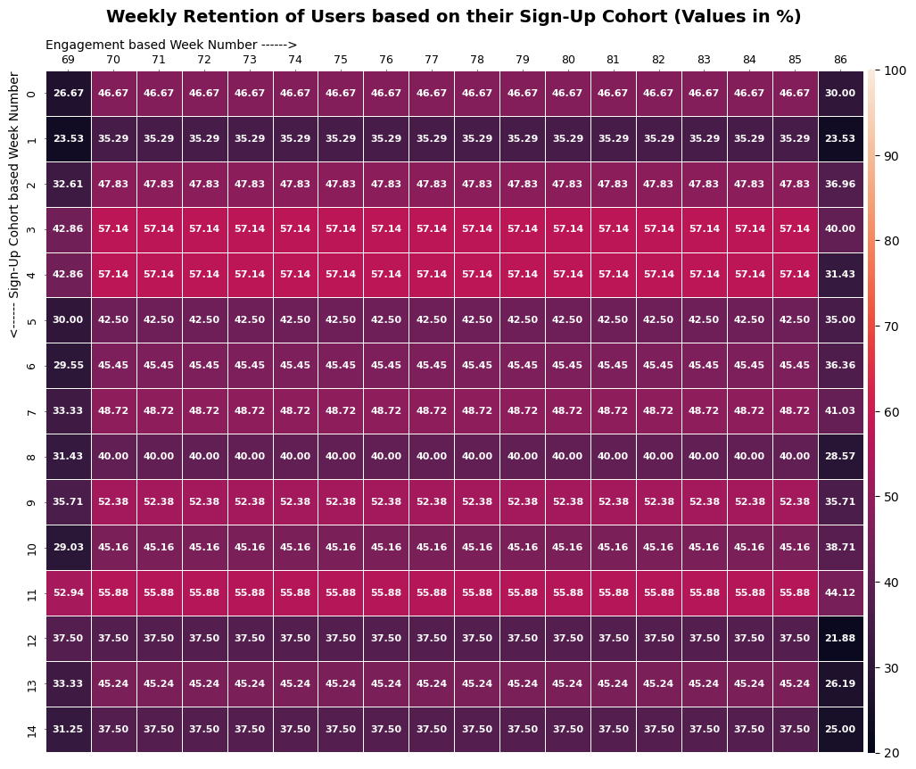
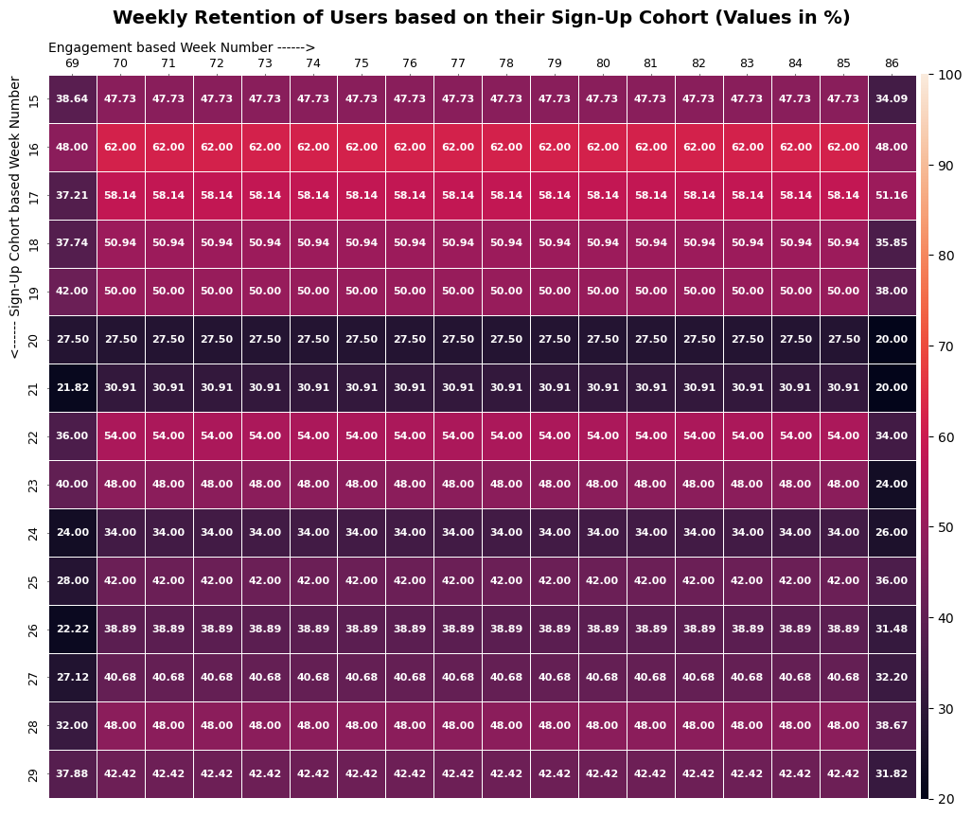
Insights
Case Study 2: Investigating Metric Spike
Result:-

Slide 38
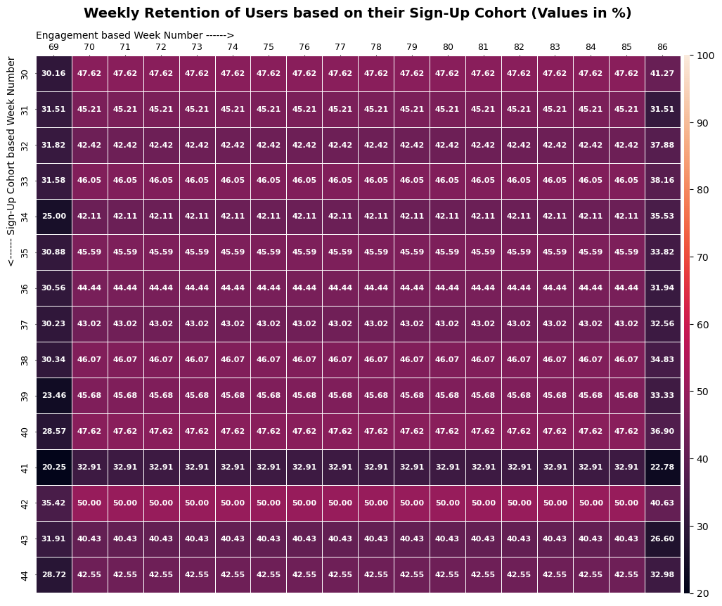
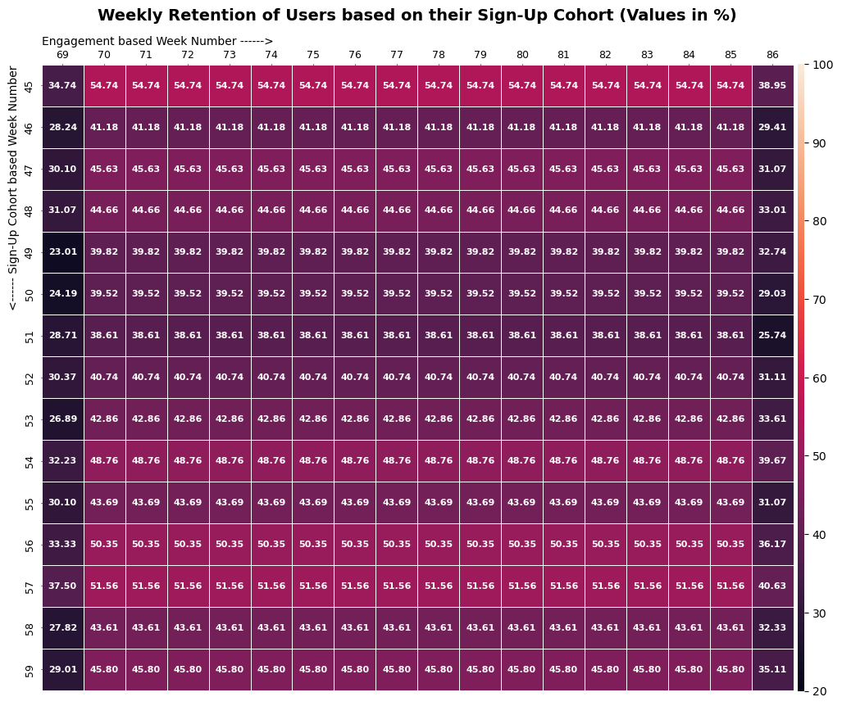
Insights
Case Study 2: Investigating Metric Spike
Result:-

Slide 39
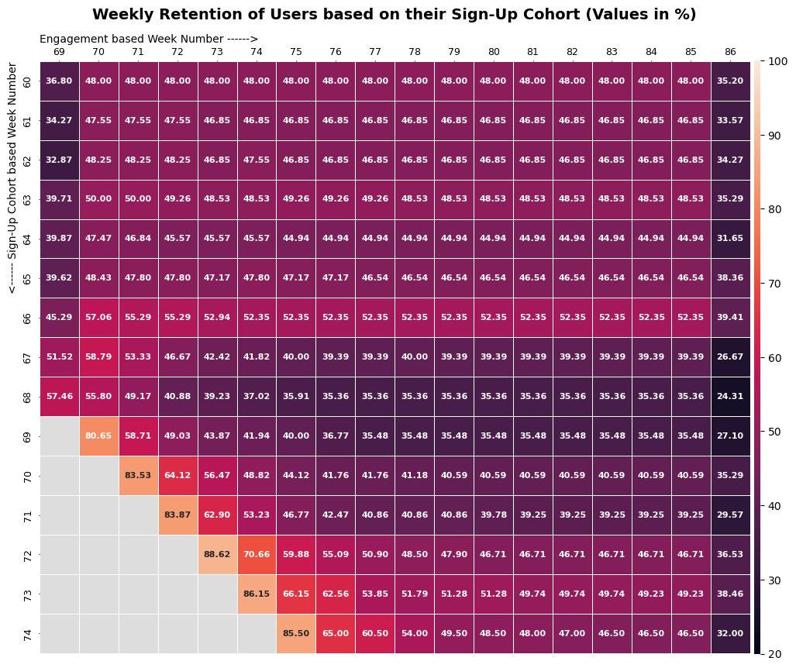
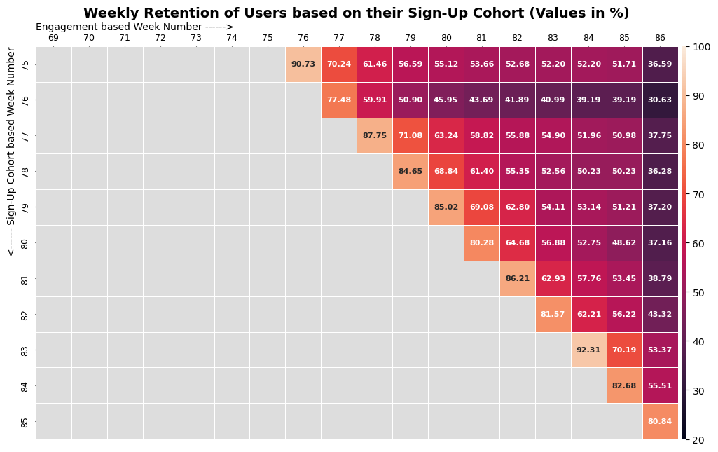
Insights
Case Study 2: Investigating Metric Spike
Result:-

Slide 40
Insights
Case Study 2: Investigating Metric Spike
Insights:-
From the plots, we can observe that for sign-up cohort weeks before 69, the retention rate for 69th event week is very low i.e. between 20% and 45% for most sign-up cohort weeks but it increases slightly after that to remain between 40% and 50% for most of the event weeks. One reason that may be contributed to above trend is that for sign-up cohort weeks before 69th week, the users were dormant for a number of days before starting to perform various events on the 69th week and increasing the number of events after that week.
From 69th sign-up week onwards, the retention rate of the very next week is very high i.e. between 77% and 93% but it decreases after that as the weeks pass. One reason that may be contributed to above trend is that for sign-up cohort weeks on and after 69th week, the event weeks are starting right away i.e. the users are not dormant after signing up. The reason for decrease after the first event week may be contributed to the excitement of users after signing up which decreases as weeks pass.

Slide 41
Insights
Case Study 2: Investigating Metric Spike
Insights:-
We can observe that the retention rate is remaining same for most of the middle event weeks. On further investigation, we found that event “sent_weekly_digest” forms majority of the events for most of the event weeks from 69 to 85 and the number of occurrence of this event is remaining constant for most of the middle overs for a given sign-up cohort week.
The last event week i.e. 86th event week have the lowest retention rate except for the 85th sign-up cohort week. The retention rate for most of the sign-up cohort weeks are between 20% and 35% for 86th event week. One reason that may be contributed to this decrease is that as the week calculation started on Tuesday since 2013-01-01 was Tuesday, so the next Monday will be counted as one whole week. Now the last event week ends on Sunday, i.e. one day less which means less number of events which contributes to comparatively low retention rate.

Slide 42
Insights
Case Study 2: Investigating Metric Spike
D. Weekly Engagement Per Device:
Objective: Measure the activeness of users on a weekly basis per device.
Task: Write an SQL query to calculate the weekly engagement per device.
Query:-
query1='''SELECT device, TIMESTAMPDIFF(WEEK, \'2013-01-01 04:40:10\', DATE_FORMAT(STR_TO_DATE(occurred_at, \'%d-%m-%Y %H:%i\'), \'%Y-%m-%d %H:%i:%S\')) AS wk, COUNT(user_id) as Cnt
FROM cs_2_t_2 WHERE event_type = \'engagement\‘ GROUP BY device, wk ORDER BY device'''
query2='''SELECT device AS Device, ROUND(AVG(q1.Cnt), 2) AS Avg_Week_Eng_P_Dev
FROM ({}) AS q1 GROUP BY device ORDER BY Avg_Week_Eng_P_Dev DESC'''.format(query1)
df5=pd.read_sql_query(query2, conn)

Slide 43
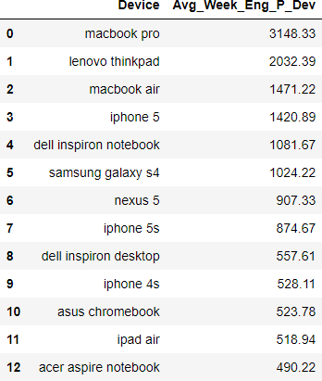
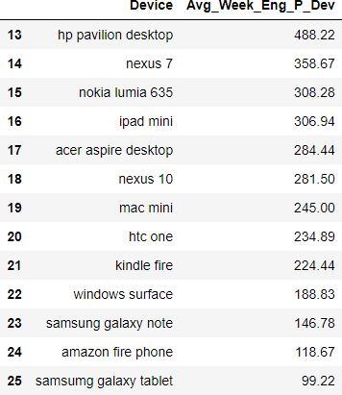
Insights
Case Study 2: Investigating Metric Spike
Result:-

Slide 44
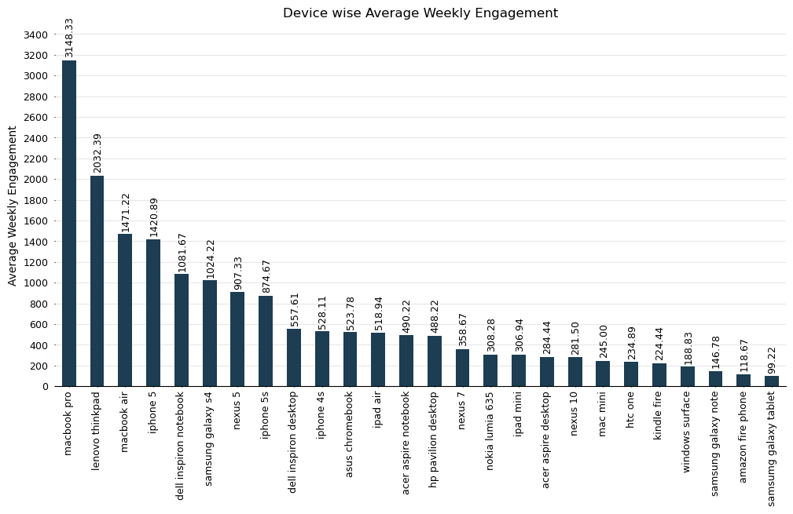
Insights
Case Study 2: Investigating Metric Spike
Result:

Slide 45
Insights
Case Study 2: Investigating Metric Spike
Query: (Here we group the devices based on their companies and check the weekly engagement per company)
query1='''SELECT CASE
WHEN INSTR(device, \'mac\') OR INSTR(device, \'macbook\') OR INSTR(device, \'iphone\') OR INSTR(device, '\ipad\') THEN \'APPLE\'
WHEN INSTR(device, \'dell\') THEN \'DELL\' WHEN INSTR(device, \'windows\') THEN \'MICROSOFT\'
WHEN INSTR(device, \'kindle\') OR LOCATE(\'amazon\', device) THEN \'AMAZON\'
WHEN INSTR(device, \'samsung\') OR INSTR(device, \'samsumg\') THEN \'SAMSUNG\'
WHEN INSTR(device, \'lenovo\') THEN \'LENOVO\' WHEN INSTR(device, \'nexus\') THEN \'LG\'
WHEN INSTR(device, \'acer\') THEN \'ACER\' WHEN INSTR(device, \'asus\') THEN \'ASUS\'
WHEN INSTR(device, \'htc\') THEN \'HTC\' WHEN INSTR(device, \'nokia\') THEN \'NOKIA\'
WHEN INSTR(device, \'hp\') THEN \'HP\‘
ELSE \'NO COMPANY\'
END AS Company,
TIMESTAMPDIFF(WEEK, \'2013-01-01 04:40:10\', DATE_FORMAT(STR_TO_DATE(occurred_at, \'%d-%m-%Y %H:%i\'), \'%Y-%m-%d %H:%i:%S\')) AS wk,
COUNT(user_id) AS cnt FROM cs_2_t_2 WHERE event_type = \'engagement\‘ GROUP BY Company, wk ORDER BY Company'''
query2='''SELECT Company, ROUND(AVG(q1.Cnt), 2) AS Avg_Week_Eng_P_Com FROM ({}) AS q1 GROUP BY Company ORDER BY Avg_Week_Eng_P_Com
DESC'''.format(query1)
df6=pd.read_sql_query(query2, conn)

Slide 46
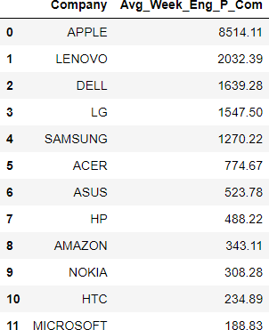
Insights
Case Study 2: Investigating Metric Spike
Result:-

Slide 47
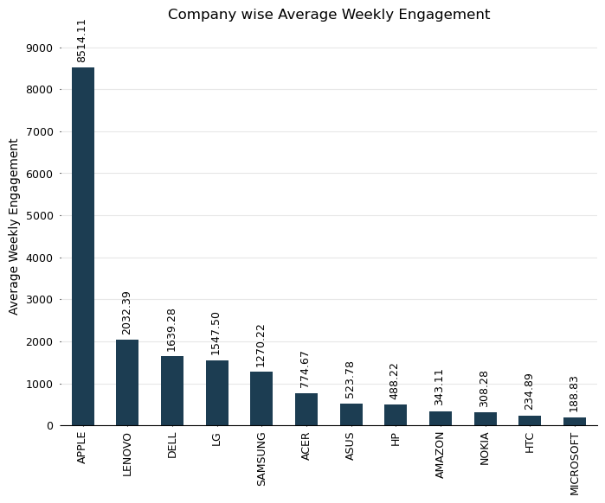
Insights
Case Study 2: Investigating Metric Spike
Result:

Slide 48
Insights
Case Study 2: Investigating Metric Spike
Insights:-
From the first plot, we can observe that the most widely used device for engagement on weekly basis is Macbook Pro followed by Lenovo thinkpad and Macbook Air at distant second and third position respectively. All three devices are laptops. It is understandable as these are formal events mostly used in corporate environment.
From the second plot, we can observe that devices from Apple are most widely used for engagement on weekly basis followed by Lenovo and Dell at distant second and third position respectively. This trend may again be contributed to the fact that the events are formal in nature which are mostly used in corporate environment. And for efficient corporate works, Apple’s Macbooks are famous and reliable. Also all three are primarily laptop brands with Apple producing phones as well.

Slide 49
Insights
Case Study 2: Investigating Metric Spike
E. Email Engagement Analysis:
Objective: Analyze how users are engaging with the email service.
Task: Write an SQL query to calculate the email engagement metrics.
Query:-
query1='''SELECT action, TIMESTAMPDIFF(WEEK, \'2013-01-01 04:40:10\', occurred_at) AS wk, COUNT(user_id) as Cnt
FROM cs_2_t_3 GROUP BY action, wk ORDER BY action'''
query2='''SELECT action, ROUND(AVG(q1.Cnt), 2) AS Avg_Week_Email_Eng
FROM ({}) AS q1 GROUP BY action ORDER BY Avg_Week_Email_Eng DESC'''.format(query1)
df7=pd.read_sql_query(query2, conn))

Slide 50
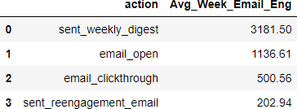
Insights
Case Study 2: Investigating Metric Spike
Result:-

Slide 51
Insights
Case Study 2: Investigating Metric Spike
Insights:-
From the above table, we can observe that most email activity is related to sent_weekly_digest followed by email_open. It is understandable since sent_weekly_digest from the name suggests some weekly email to be sent to every user and email_open from the name suggests opening of email.

Slide 52

Result
Through this project, I was able to understand how important Operational Analytics is for an organizations as it helps in identifying and understanding areas where improvement is required.
In this project I was able to get insights about various questions like rate of job reviews, share of languages, patterns of user engagement on weekly basis, growth of users etc.I can communicate these insights to the management team as per the requirements using which they can make proper data-driven decisions.
This Project has also helped me in understanding the advance functions of SQL and its working. Also, since I used python environment to run the SQL queries, I was also able to understand how to link the two platforms.
Image Source: Google Images

Slide 53
Thank You

